Slide 1


Oskar Lubiński
Sociology Master degree II Year
Global Consulting Agencies’ Scandals as a Display of a Failure of Contemporary Narratives about Capitalism
Nicolaus Copernicus University in Toruń (UMK)

Slide 2

Introduction
What is the subject of todays’ presentation
  Global Consulting Agencies’ scandals
  Power Elite
  Contribution to system failure

Slide 3

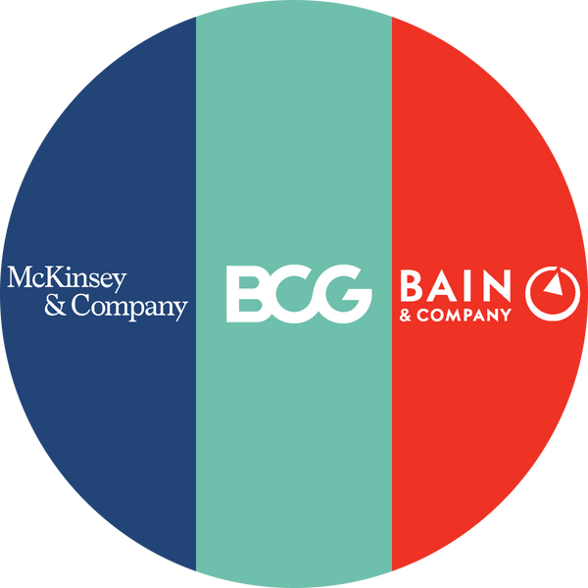
Principal Global Consulting Agencies
Big Four
Big Three
  Specializing primarily in traditional consulting services, particularly in the realm of accounting.
  Provide a broad spectrum of services.
  Rank among the most prominent consulting firms, surpassing even the Big Three in size.
  Originally recognized as the Big Eight, these firms underwent mergers post-scandals, resulting in the establishment of today's Big Four.
  One of the oldest consulting firms still operational to this day, with roots tracing back to the 19th century.
  Engage in public investment audits to enhance visibility in the mass media and prestige.
  Primarily focused on consulting services.
  Represent fairly new American enterprises.

Slide 4
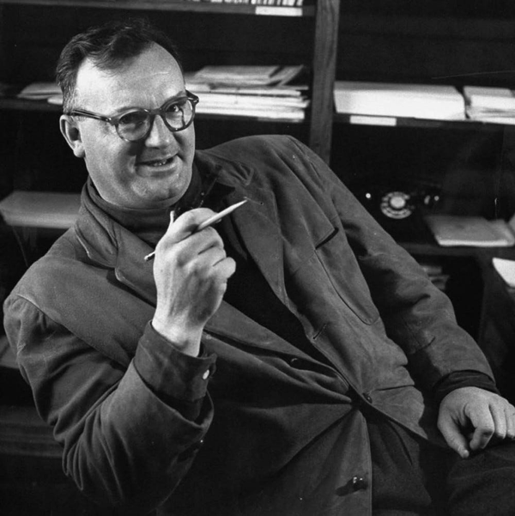



The term was originally introduced by the American sociologist Charles Wright Mills.
"Power Elites"
According to Mills (1956: 9), the power elite comprises individuals occupying upper-tier positions in economic, political, and military sectors within contemporary society.

Slide 5

Connection Between Global Consulting Firms and Power Elites
  Influence on Decision-Making
  Access to Information
  Networks of Power
  Creation of Elites
  Global Influence

Slide 6
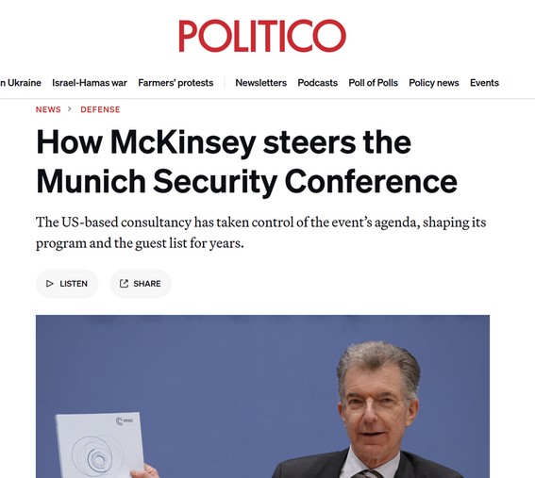
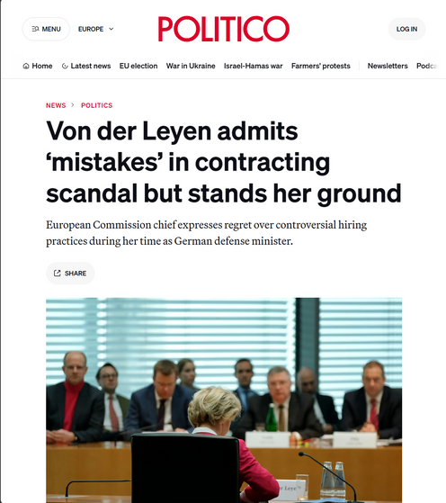
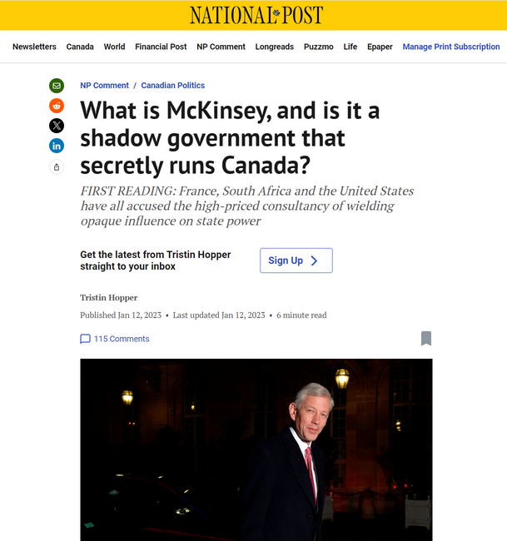
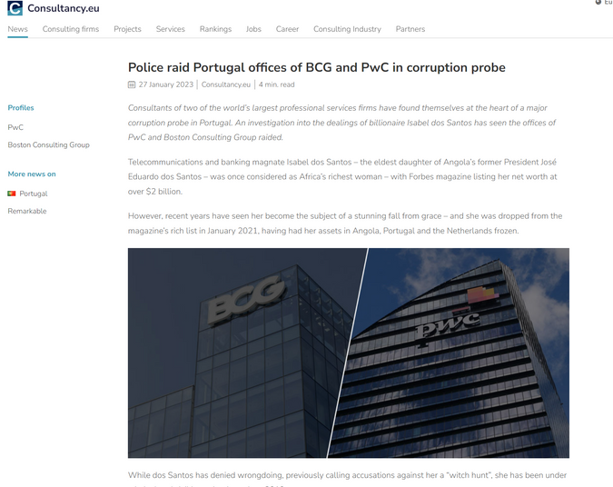
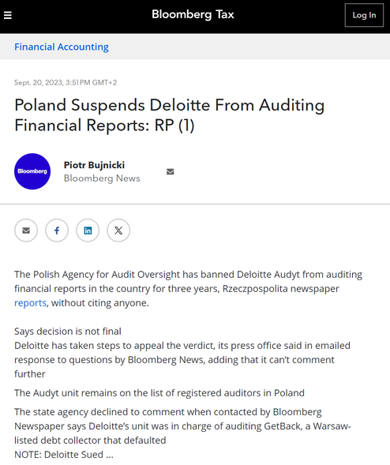
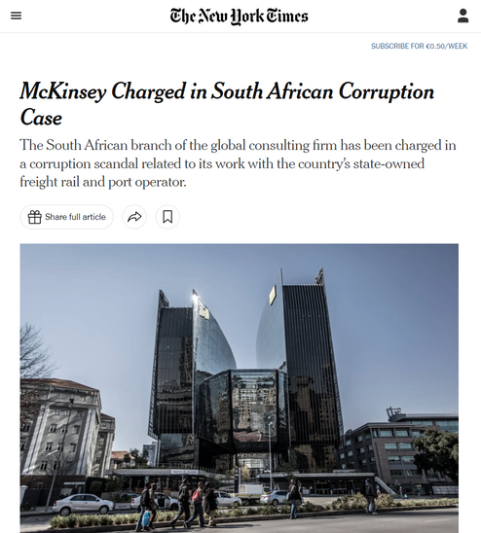
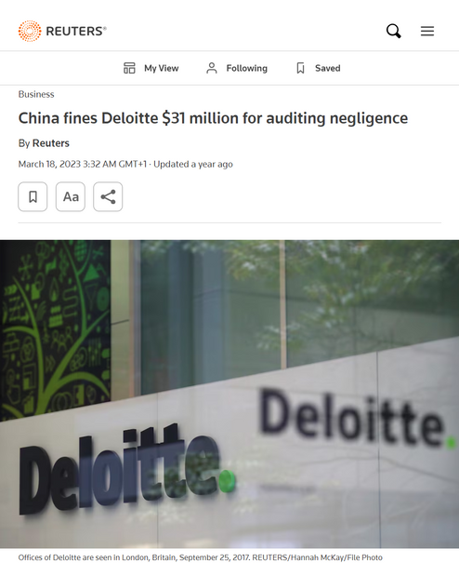
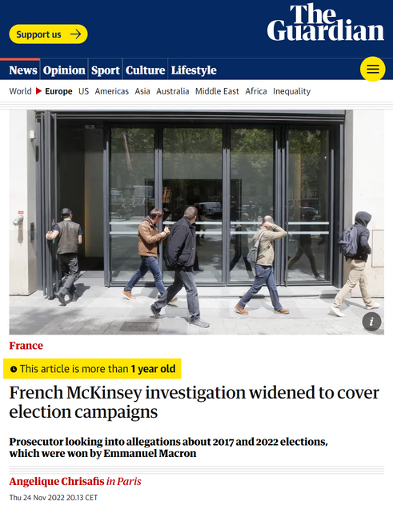
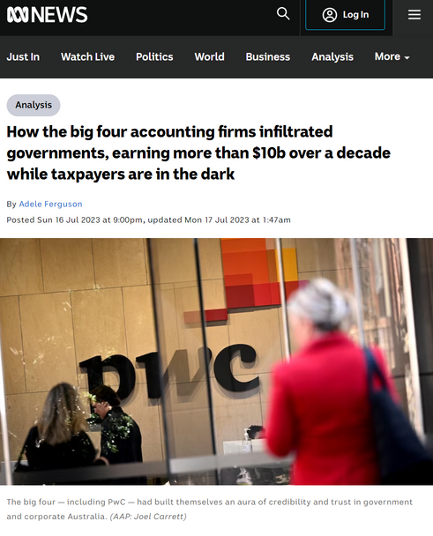

"Prominent Scandals"

Slide 7

Most prominent Scandals
  “Purdue Pharma Scandal
  “Rikers Island Scandal”
  Working with totalitarian goverments

Slide 8


Can we percieve Global Consulting Agencies’ Scandals as a Display of a Failure of Contemporary Narratives about Capitalism?

Slide 9

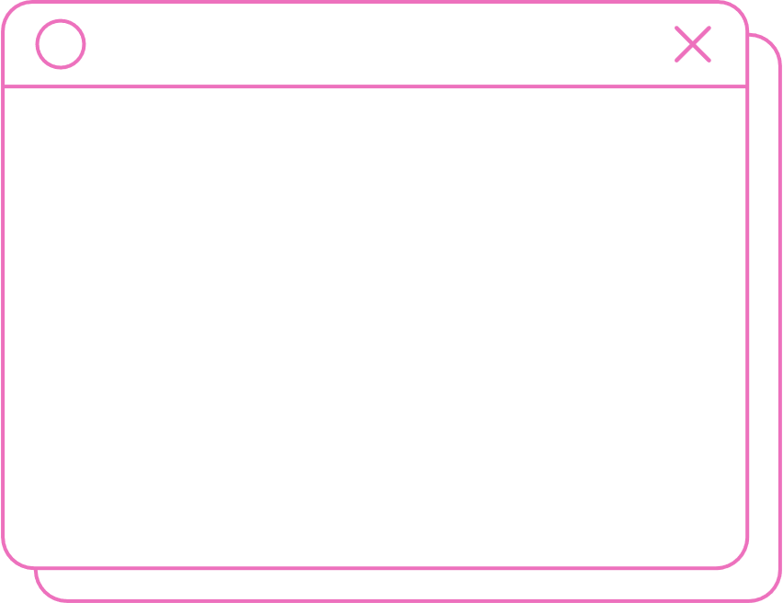
What perspectives of failure can we identify from the Global Consulting Agencies Scandals?
  Neoliberalism intersection (Failure Regime)
  Failure of state
  Failure of active actors (they got caught)
  Failure of stated values
“Neoliberalism, according to this reading, does not only bring about particular regimes of failure that are both an outcome and a resource of the dynamics of capitalism, but it also favours failure that, in a similar vein to neoliberalism, is itself unequal, invisibilizing, cancelling out, and prone to reproduce vulnerabilities and asymmetries”
(Mica et al., 2023)

Slide 10
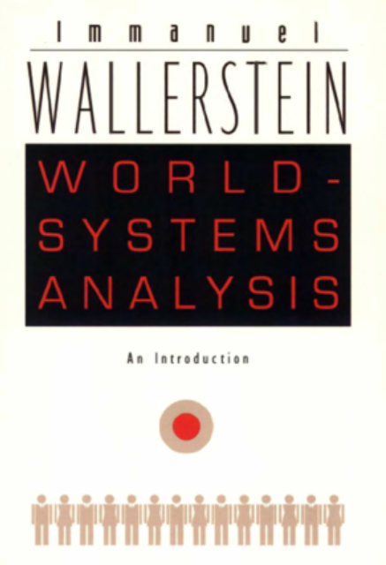

What contributes to contemporary systems’ failure? (Summary)
1
Contribution to global Core-Peripheries assymetries
Reproduction of global inequalities
2
Weakening goverments and public institutions sovereignty
3
4
Erosion of Public Trust in Experts

Slide 11

Q&A
Oskar Lubiński:
email: oskarshadow00@gmail.com

Slide 12
References
How McKinsey steers the Munich Security Conference. (2023, February 17). POLITICO. https://www.politico.eu/article/mckinsey-steers-munich-security-conference-german-government-mcleyen-berlin-von-der-leyen-suder-wolfgang-ischinger-joe-biden-nato/
‌Mazzucato, M., & Collington, R. (2023). The Big Con. Penguin.
Mica, A., Pawlak, M., Horolets, A., & Kubicki, P. (2023). FAIL! Are We Headed towards Critical Failure Studies? Routledge EBooks, 3–22. https://doi.org/10.4324/9780429355950-2
‌
Strange, S. (1996). The Retreat of the State. https://doi.org/10.1017/cbo9780511559143
Szalacha-Jarmużek, J. (2013). Instrumentarium globalnego panowania. Zysk i S-ka.
‌
Von der Leyen admits “mistakes” in contracting scandal but stands her ground. (2020, February 13). POLITICO. https://www.politico.eu/article/von-der-leyen-admits-mistakes-in-contracting-scandal-but-stands-her-ground/

